Slide 1

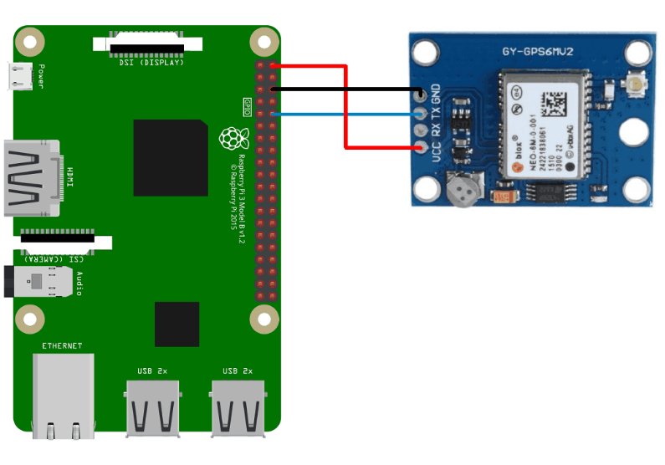
REAL-TIME LOCAtION SYSTEM FOR INVIDING PERSONS
members:
JULIO BODERO CASTRO
KARLA BOWEN RUGEL
JOCELYN MIRANDA REAL
PAÚL SÁNCHEZ CASTRO
JEAN VERA BUSTAMANTE

Slide 2
ANALYSIS OF THE PROBLEM
Blindness hinders many aspects of the day to day of people who suffer from it. The disability council reveals that the number of people with this disability from a level of 85 to 100% is 926 people in the province of Guayas.
Blind people, among many difficulties they have to overcome, a very particular one is to move from one point of the city to another.

Slide 3
OBJECTIVES
Consider
Consider each detail of the problem, thus empathizing with the user, achieve a solution as effective as possible.
Investigate
Investigate geolocation technologies to choose the most suitable for the project.
Choose
Choose a suitable prototyping platform for a wearable.
Program
Program the device in a Linux environment, taking advantage of the Open Source codes, to show its location coordinates by console.
Develop
Develop a code in Python that allows to show the location of the device on the map.
Develop
Develop a program that allows interactive guidance between the device and the user to reach the destination point.
Implement
Implement an obstacle prevention system in front of the user, using a presence sensor to avoid a trip or accident

Slide 4
HARDWARE RESOURCES
Raspberry Pi 3 model b
It is a high performance and low cost minicomputer, belonging to the family of prototyping platforms and very popular due to its qualities.
GPS module (GY-GPS6MV2)
This module is able to recognize the position of the device in terms of longitude and latitude; also the height taking as reference the level of the sea.
Micro SD card
This device is necessary because it will act as the main storage of the Raspberry and it will install the operating system (which will be a Linux distribution). It can be at least 8GB.
LiPo Battery
According to the power requirements of the Raspberry Pi, the 2500mAh LiPo battery can supply what is requested.
Ultrasonic Sensor (HC-SR04)
Its function will be to measure distance from an object near the front of the sensor by using ultrasound waves.
DC motors and Buzzers
These devices will be used to direct the user through stimuli.

Slide 5
SOFTWARE RESOURCES
Raspbian OS
This distribution of Linux is one of the operating systems with which the Raspberry Pi is compatible. As it comes from Linux we can count on the useful command line interface to program.
Python IDE
It offers a friendly work environment to be able to compile and execute the corresponding code. Python is a high-level language and interpreted, which makes it a good choice for any type of programming such as object-oriented programming.
Google Maps API
It offers users the possibility of developing web applications that allow to show instructions to reach a certain street, among other characteristics. This API will be used to interact with the location data

Slide 6

GENERAL DEVELOPMENT PROCESS
Download
Download the Raspbian operating system and install it on the micro SD card.
Download and install
Download and install Python IDE.
Schedule
Schedule the Raspberry Pi so that it obtains its GPS location and sends it to the cloud so the user can track the positioning.
Be
Google Maps will be used to display and manage device location data.

Slide 7
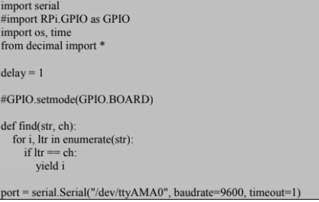
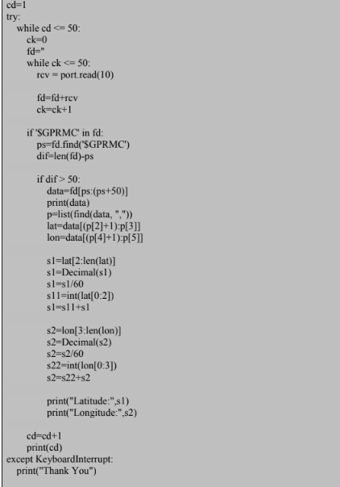
Raspberry Pi and GPS programming
Small part of the code used to configure the Raspberry PI and the GPS.

Slide 8
Connection of the Raspberry PI and the GPS.
When this connection is made, the Raspberry Pi and the GPS are turned on, the red led lighting up.
To have a reliable signal, GPS must have an address to the sky or near door or windows.
There may be problems to receive the signal through different environments such as metal, forests, mountains and more.

Slide 9
SUCCESS CRITERIA
GPS recognition is achieved with little demand for resources and in a not too rigorous way.
The presence sensor implemented is feasible both in portability and in the use of resources from the prototyping platform.
The total implementation of the project does not negatively affect the operation of the platform.
The production cost is small compared to the cost of launching the final product, thus representing a desirable financial performance.

Slide 10
RISKS AND DEPENDENCIES
The GPS location depends on the type of antenna that will be used, affecting the reception capacity and therefore the location effectiveness.
In case of problems with GPS location, you must proceed with another geolocation system.
While the sensor will avoid certain trips or collisions, there is no guarantee that any driver will not miss a traffic signal or a red light.

Slide 11
PROTOTYPE BUDGET
 | EXPENSES | DETAIL | QTY | UNIT VALUE | TOTAL
 |  | Raspberry Pi 3 | 1 | $35,00 | $35,00
 |  | HC-SR04 Sensor | 1 | $3,50 | $3,50
 |  | Buzzer | 1 | $0,15 | $0,15
 |  | Miscellaneous | 1 | $10,00 | $10,00
 |  | GPS module GPS6MV2 | 1 | $13,00 | $13,00
 |  |  |  |  | $61,65
 | INCOME | DETAIL | QTY | UNIT VALUE | TOTAL
 |  | SALE OF PROTOTYPE | 1 | $100,00 | $100,00

Slide 12
Conclusions & recommendations

